Slide 1

DISCOVERING KNEE OSTEOARTHRITIS USING CNN ENCHANCED WITH ALEX NET
Under the guidance of
Ms.SUJATHA
Assit.Professor,Dept.of CSE
Name of the students
B.M.Chand (222P1A3107)
B. Sri Harika Padma Latha (222P1A3109)
M.Prathima (222P1A3123)
R.Amrina (222P1A3139)
S.Muskan(222P1A3145)
Department of Computer Science and Engineering -
Artificial Intelligence

Slide 2
Abstract
Knee Osteoarthritis (KOA) is a prevalent and chronic degenerative joint disease that significantly affects the quality of life of millions of people worldwide, particularly the aging population. Early and accurate detection of KOA is essential for effective intervention, timely treatment, and prevention of severe joint damage, thereby improving patient mobility and overall outcomes. Traditional diagnosis mainly relies on the manual analysis of knee X-ray images by radiologists, which is time-consuming and highly dependent on clinical expertise. Earlier automated methods based on conventional machine learning techniques such as Support Vector Machine (SVM), Random Forest (RF), and k-Nearest Neighbors (k-NN) with handcrafted features often suffer from limited accuracy due to their inability to capture complex image patterns. To overcome these limitations, this study proposes an innovative automated KOA detection system using a hybrid deep learning approach based on Convolutional Neural Networks (CNNs). The proposed ensemble model integrates the strengths of AlexNet, MobileNet, and ResNet architectures for robust deep feature extraction and classification of knee X-ray images into different stages of osteoarthritis. Additionally, transfer learning and image preprocessing techniques are employed to enhance feature learning and improve image quality, leading to better model performance. The obtained results show that the proposed model delivers high accuracy in classifying different stages of KOA, enabling early diagnosis and supporting timely medical intervention to improve patient outcomes.

Slide 3
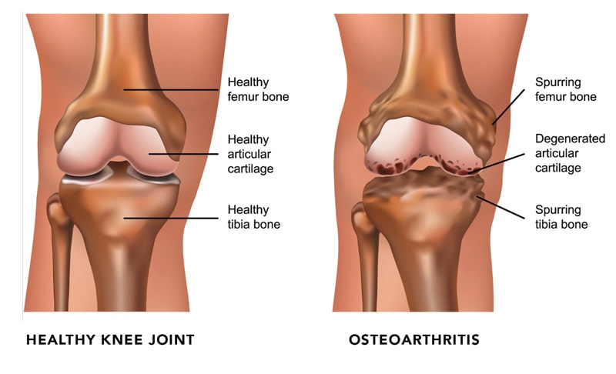
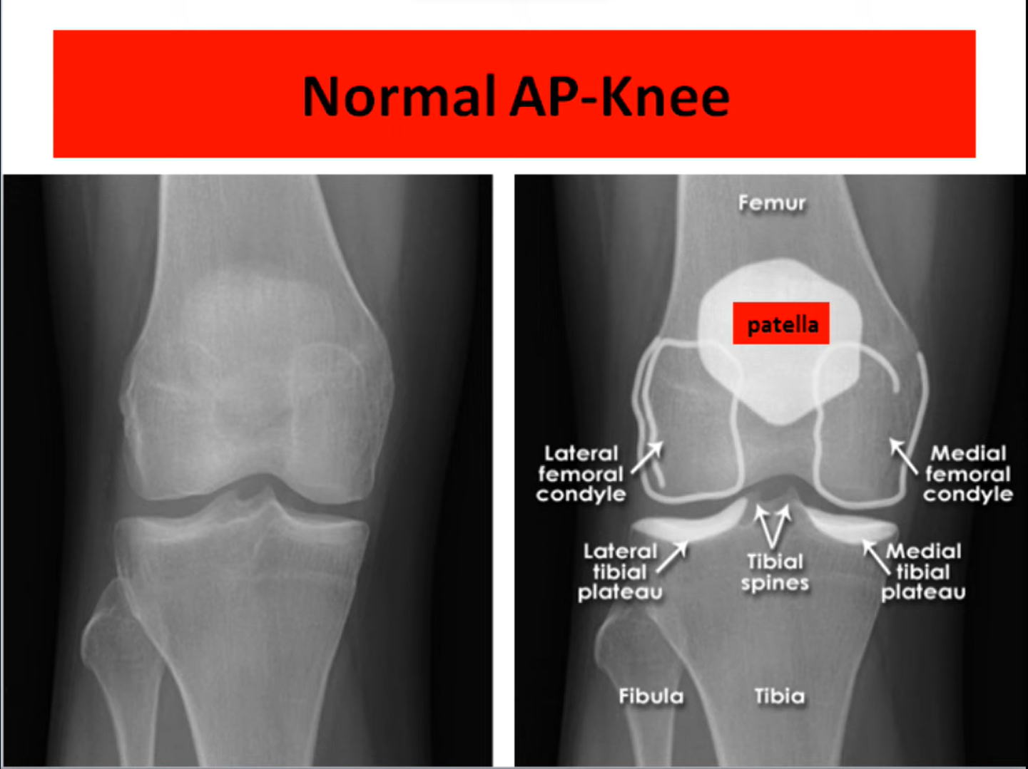
WHAT IS KNEE OSTEOARTHRITIS?
Knee osteoarthritis is a common problem in which the knee joint slowly gets damaged over time.
Finding this condition early is important for proper treatment and better recovery.
It usually happens because of aging and repeated use, which causes the cartilage in the knee to gradually wear down. It is more common in older people.

Slide 4
Introduction
Knee Osteoarthritis (KOA) is a common joint disorder that affects millions of people worldwide. It occurs when the cartilage in the knee joint gradually wears down over time, leading to pain, stiffness, swelling, and difficulty in movement. This condition is more commonly seen in older adults due to aging, but it is also increasing in younger individuals because of obesity, injuries, lack of exercise, and unhealthy lifestyle habits.
Early detection of KOA is important to avoid severe joint damage and to improve the quality of life of patients. Traditional diagnosis mainly depends on the manual examination of knee X-ray images by doctors, which can be time-consuming and depends greatly on medical expertise. In some cases, early-stage osteoarthritis may not be identified accurately. Earlier methods also used traditional machine learning techniques such as Support Vector Machine (SVM), Random Forest (RF), and k-Nearest Neighbors (k-NN) for classification, but these methods often provided limited accuracy.
To overcome these challenges, this project proposes an automated KOA detection system using both machine learning and deep learning techniques. The proposed system uses multiple Convolutional Neural Network (CNN) models such as AlexNet, MobileNet, and ResNet to analyze knee X-ray images and classify the severity stages of osteoarthritis. Transfer learning and image preprocessing methods are also applied to improve the performance and accuracy of the model.

Slide 5
System Requirements
Hardware Requirements:
System : Intel i5 Processor (or i3 minimum)
Hard Disk : 256 GB
RAM : 8 GB
Software Requirements:
Operating System : Windows 10
Programming Language : Python
Development Tools : VS Code
Libraries : PyTorch, NumPy, OpenCV, Matplotlib, Flask
Dataset : Knee X-ray images

Slide 6
Literature Survey
S.NO | YEAR | AUTHORS | TITLE | OUT COMES
1 | IEEE, 2022 | T. Sivakumari; R. Vani | Implementation of AlexNet for Classification of Knee Osteoarthritis | This project explores the use of the AlexNet model for classifying knee osteoarthritis (KOA) severity. By leveraging deep learning technology, the aim is to enhance diagnostic accuracy and reduce the pressure on clinicians. The project assesses the model's performance in comparison to other models, emphasizing the potential of artificial intelligence in improving KOA diagnosis.
2 | IOP journal, 2018 | Anifah, L., Purnomo, M., Mengko, T., Purnama, I | Osteoarthritis severity determination using self organizing map based Gabor kernel. | This research utilizes a Gabor kernel-based x-ray image template to assess knee osteoarthritis severity in Indonesia. Through image processing, learning, and testing stages, the study achieves accuracy rates for different severity levels. Results show promise for the research to serve as a decision support system for medical practitioners in determining KL-Grade on x-ray images of knee osteoarthritis.

Slide 7
LITERATURE SURVEY
S.NO | YEAR | AUTHORS | TITLE | OUT COMES
3 | ICPR, 2016 | Antony, J., McGuinness, K., O’Connor, N.E., Moran, K | Quantifying radiographic knee osteoarthritis severity using deep convolutional neural networks | This paper introduces a superior method for automatically quantifying knee osteoarthritis (OA) severity, utilizing deep convolutional neural networks (CNN). The approach significantly enhances classification accuracy compared to traditional methods, showcasing notable progress on the Osteoarthritis Initiative (OAI) dataset.
4 | IEEE, 2013 | He, K., Sun, J., Tang, X | Labeled Optical Coherence Tomography (OCT) and Chest X-ray Images for Classification | The dataset in "Deep learning-based classification and referral of treatable human diseases" includes validated OCT and Chest X-Ray images. OCT images are split into training and testing sets, labeled by disease type, randomized patient ID, and image number. This dataset is essential for the study's deep learning-based classification and referral of treatable human diseases.

Slide 8
EXISTING SYSTEM
The existing system for detecting Knee Osteoarthritis mainly relies on manual analysis of knee X-ray images by radiologists. Doctors evaluate the images using standard grading methods like the Kellgren–Lawrence scale, but this process is subjective and depends on the experience of the medical professional, which can lead to inconsistent results. It is also time-consuming and difficult to handle large numbers of patients.
To overcome manual limitations, traditional machine learning methods such as Support Vector Machine (SVM), K-Nearest Neighbors (KNN), and Random Forest have been used. However, these methods require manual feature extraction, where important features like texture, shape, and pixel intensity must be identified by experts. This makes the process complex, less flexible, and dependent on human knowledge. These models also struggle to detect subtle patterns in early-stage osteoarthritis, resulting in lower accuracy and poor generalization.
In some cases, basic Convolutional Neural Networks (CNNs) are used, but relying on a single model limits performance. Such models may fail in borderline cases and cannot capture all types of features effectively. Overall, the existing system lacks full automation, scalability, consistency, and high accuracy, making it less reliable for early and large-scale diagnosis.

Slide 9
DISADVANTAGES
Time-consuming process: Manual analysis of knee X-ray images by radiologists takes more time, especially when handling a large number of patients.
Subjective results: The diagnosis depends on the doctor’s experience and judgment, which may lead to inconsistent or varying results.
Manual feature extraction: Traditional machine learning techniques require experts to manually extract features such as texture, shape, and intensity, making the process complex and dependent on human knowledge.
Lower accuracy: Methods like SVM, KNN, and Random Forest may not capture complex patterns in medical images, resulting in reduced accuracy.
Single model limitations: Basic CNN models using only one architecture may not extract all important features effectively, reducing performance in complex cases.
Lack of full automation: The existing system still requires significant human involvement, making it less efficient and less reliable.

Slide 10
Proposed System
The proposed system is an automated Knee Osteoarthritis (KOA) detection framework based on deep learning techniques. It utilizes an ensemble Convolutional Neural Network (CNN) model combining AlexNet, MobileNet, and ResNet architectures to improve classification accuracy and robustness.
The process begins with collecting knee X-ray images from a standard dataset. Image preprocessing techniques such as resizing, normalization, and noise removal are applied to enhance image quality and ensure consistency. The preprocessed images are then fed into the ensemble CNN model.
Each architecture—AlexNet, MobileNet, and ResNet—extracts deep features from the input images, and these features are combined to improve overall performance. The model is trained using transfer learning and optimized using performance metrics such as accuracy and loss.
Finally, the system classifies knee X-ray images into different severity levels (Normal, Doubtful, Mild, Moderate, Severe). The proposed system provides fast, accurate, and reliable results, assisting medical professionals in early diagnosis and effective decision-making.

Slide 11
ADVANTAGES
High accuracy due to the use of an ensemble CNN model (AlexNet, MobileNet, and ResNet).
Fully automated system, reducing manual work for doctors.
Fast diagnosis, which saves time in analyzing knee X-ray images.
Better early detection of Knee Osteoarthritis stages.
Improved reliability and consistency compared to manual analysis.
Deep feature extraction helps in identifying complex image patterns.

Slide 12
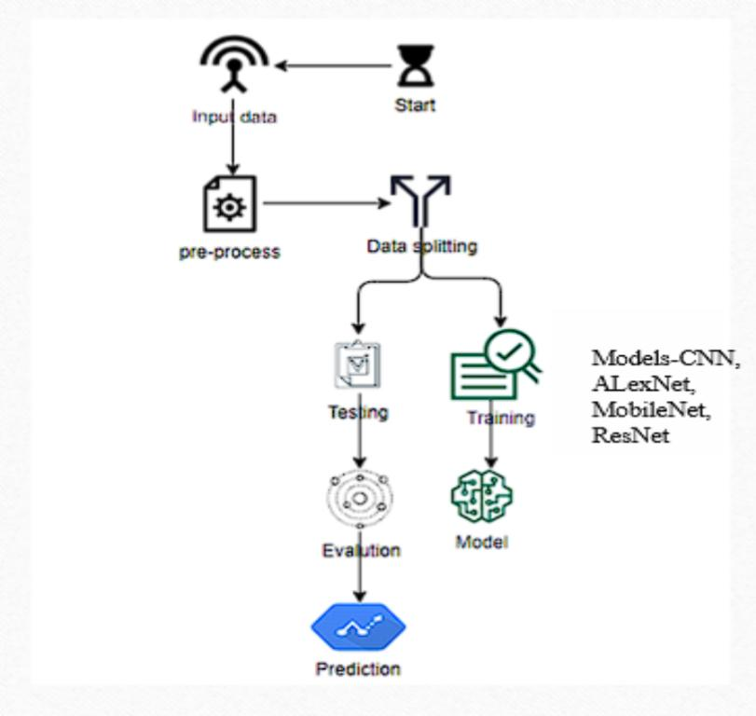
Architecture

Slide 13
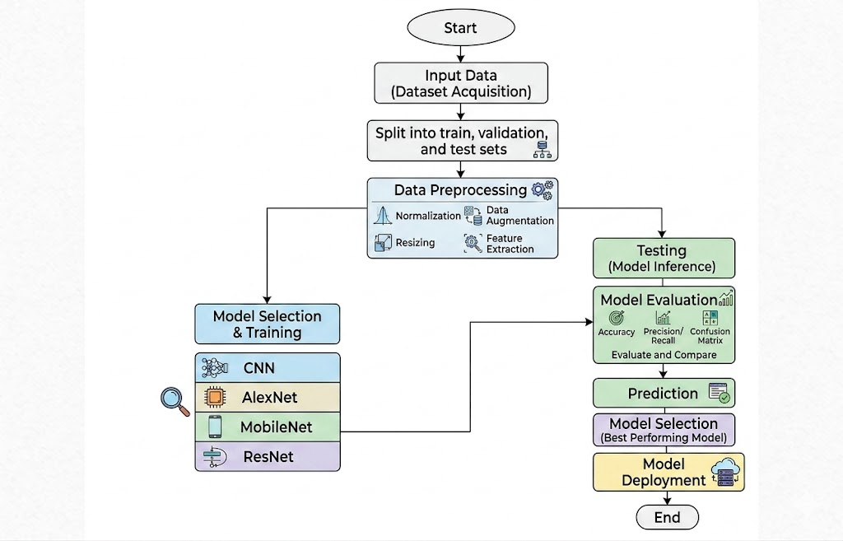
WORK FLOW
1. Importing the packages
2. Exploring the dataset
- KOA X-Ray Images
3. Image processing
- Re-scaling the Image
- Zooming the Image
- Horizontal Flip
- Reshaping the Image
4. Building the model
5. Training the model
6.Flask Framework with MySql for signup and signin
7. User Upload an image for analysis
8. The given input is preprocessed
9. The trained model is used for predicting the result
10. Final Outcome is displayed.

Slide 14
MODULES
System Modules
Module | Description
Create Dataset | The knee X-ray image dataset is collected from standard sources and divided into training and testing sets (70–80% training and 20–30% testing). This split helps in training the model effectively and evaluating its performance on unseen data.
Pre-processing | The input images are resized to a fixed size, normalized, and cleaned to remove noise. This step ensures consistency in image format and improves the quality of data for better model performance.
Training | The preprocessed training dataset is used to train the deep learning models. Techniques like transfer learning are applied using architectures such as AlexNet, MobileNet, and ResNet to improve learning efficiency and accuracy.
Classification | The trained model analyzes the input X-ray images and classifies them into different osteoarthritis severity levels such as Normal, Mild, Moderate, and Severe based on learned features.

Slide 15
User Modules
Module | Description
User Registration | New users can create an account by providing details such as name, email, password, and contact number. The system securely stores this information in the database.
User Login | Registered users can log in using their email and password. The system verifies the credentials to allow secure access to the application.
Upload Image | The user uploads a knee X-ray image through the interface. The system accepts valid image formats and prepares the image for processing.
View Results | After processing, the system displays the classification result along with the predicted severity level of osteoarthritis.
Logout | After completing the process, the user can safely log out of the system to ensure data security.

Slide 16
result
The proposed system was successfully implemented to detect and classify Knee Osteoarthritis (KOA) using knee X-ray images. The model was trained using preprocessed data and tested on unseen images to evaluate its performance. The system accurately classifies the input images into different severity levels such as Normal, Doubtful, Mild, Moderate, and Severe.
The use of multiple deep learning models (AlexNet, MobileNet, and ResNet) improves the overall performance of the system. The results show high classification accuracy and better prediction capability. The system provides fast and reliable outputs, making it useful for assisting medical professionals in early diagnosis.
Overall, the developed model demonstrates effective performance in detecting knee osteoarthritis and can be used as a supportive tool in medical diagnosis.

Slide 17

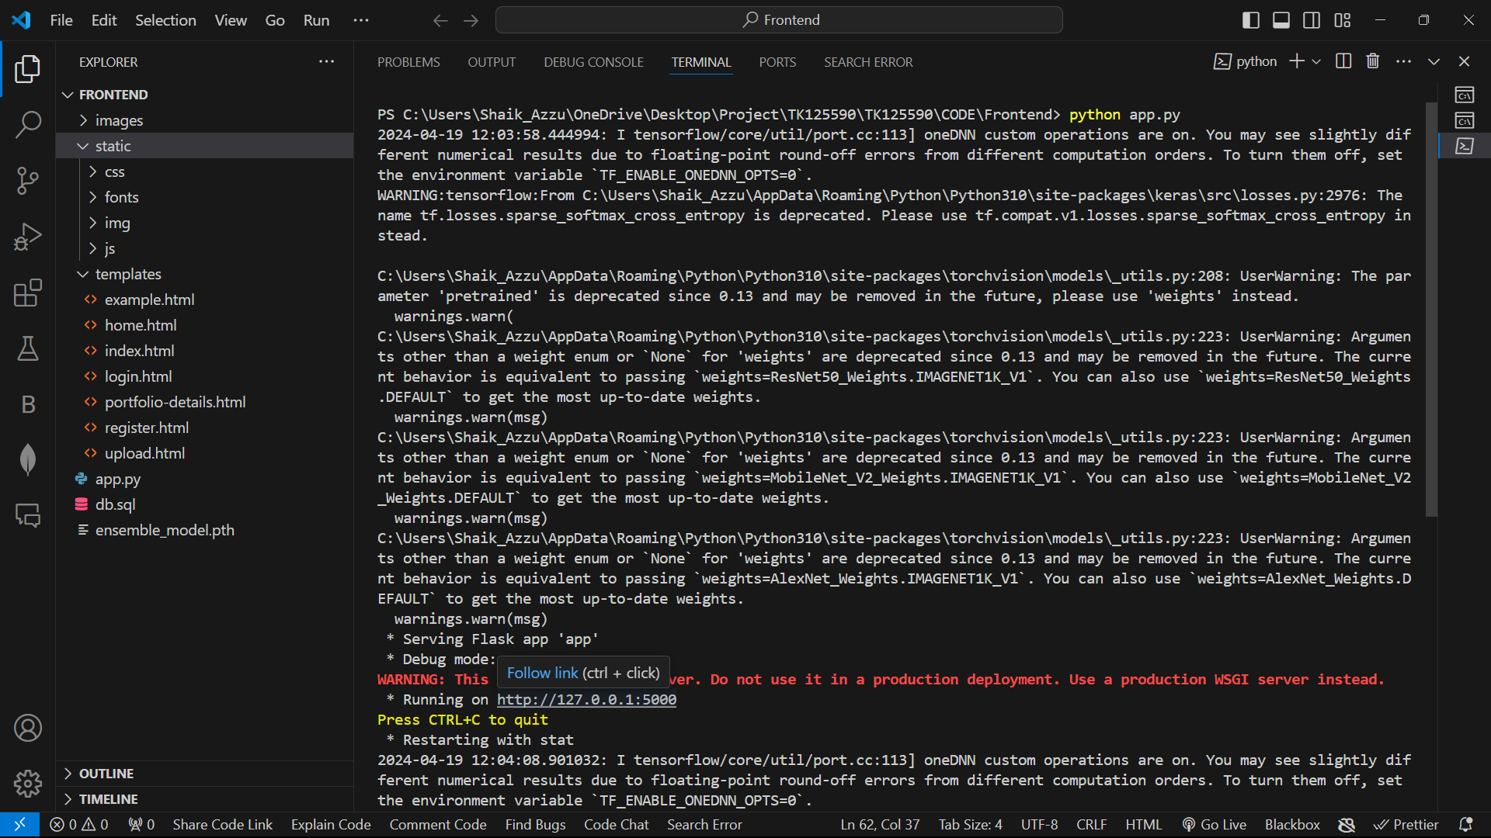
Experimental Results
Step-1
Step-2

Slide 18



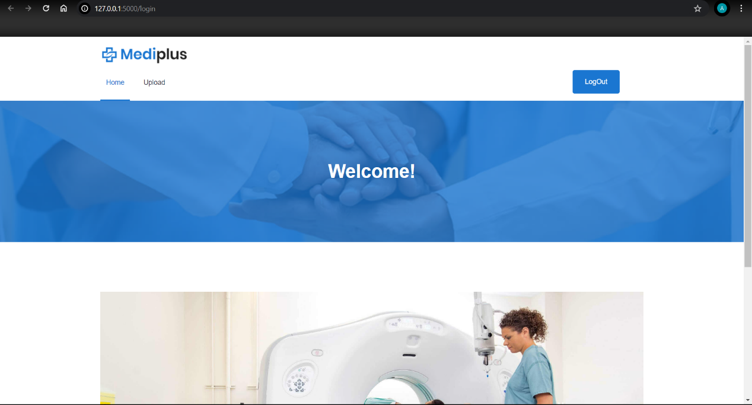
Step-3
Step-4
Step-5
Step-6

Slide 19

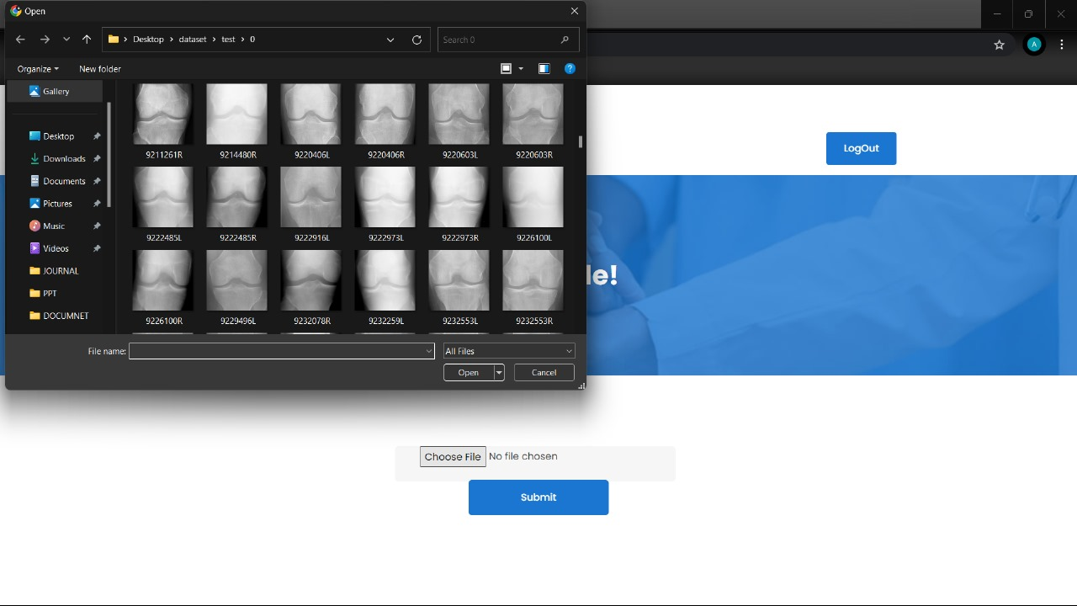
Step-7
Step-8

Slide 20
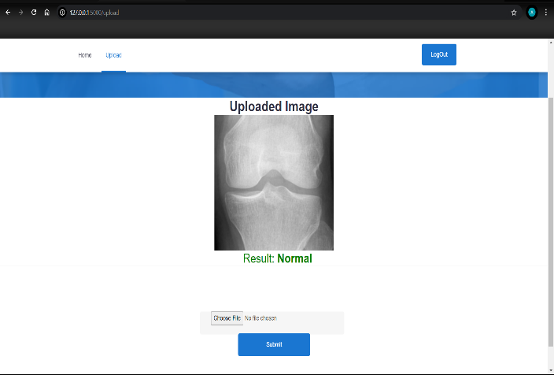
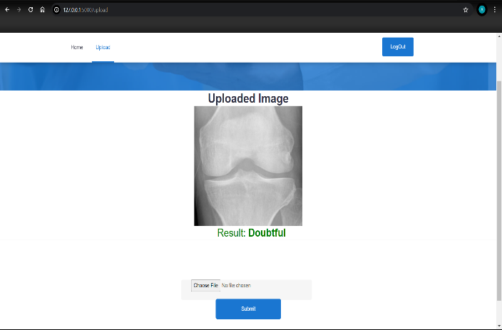
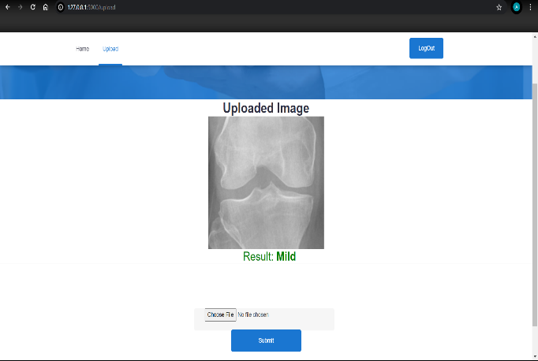
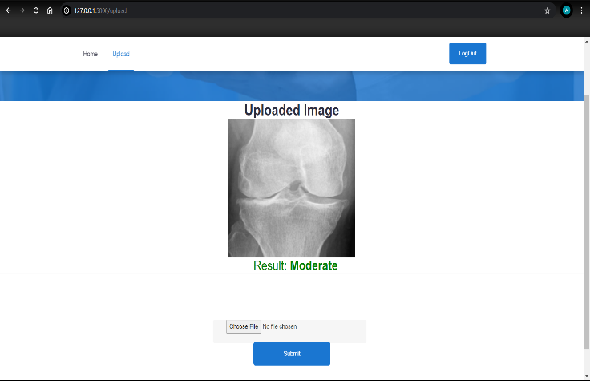
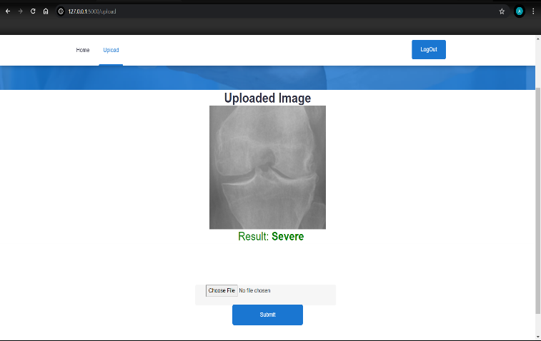
Grade-0
Grade-1
Grade-2
Grade-4
Grade-5

Slide 21
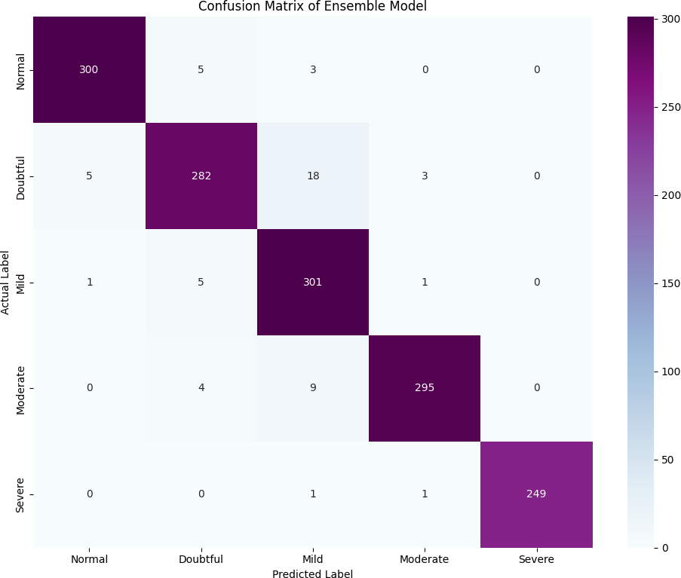
Model Accuracy
 | Precision | Recall | F1-score | Support
0 | 0.98 | 0.97 | 0.98 | 308
1 | 0.95 | 0.92 | 0.93 | 308
2 | 0.91 | 0.98 | 0.94 | 308
3 | 0.98 | 0.96 | 0.97 | 308
4 | 1.00 | 0.99 | 1.00 | 251
Total Accuracy | 0.96 |  |  | 1483

Slide 22
conclusion
This project presents an automated and efficient approach for detecting Knee Osteoarthritis (KOA) using an ensemble Convolutional Neural Network (CNN) model that integrates AlexNet, MobileNet, and ResNet architectures. By combining the strengths of multiple models, the proposed system improves classification accuracy, robustness, and generalization compared to individual CNN models. The ensemble approach effectively classifies different stages of KOA from knee X-ray images.
The system reduces manual effort, minimizes diagnostic errors, and supports the early detection of the disease, enabling doctors to make faster and better treatment decisions. Overall, the proposed deep learning-based system enhances the reliability, efficiency, and accuracy of Knee Osteoarthritis diagnosis and has strong potential for real-world medical applications.

Slide 23
Thank you

